Slide 1
Car Selling Price Prediction
GROUP
20
BABLU
SHAKTI SINGH RATHORE

Slide 2
Problem Statement
Regression is an important machine learning model for these kinds of problems OLX Group is a global online marketplace operating in 45 countries. The OLX marketplace is a platform for buying and selling services .OLX car sellers are finding it difficult to put a price on the cars they are selling.
So we predict Car selling price and we use features of the cars and their prices. For this kind of project of Price predict, we will apply the linear regression and Random forests and evaluate the result based on the training and testing a set of the data.

Slide 3
About
The data used in this project is scrapped from OLX Website. The data set contains 800 rows * 15 columns. Car Price is the column which we are going to predict here.
The 15 columns are as Name Make_Month ,No_of_Owners, Color,Type_of_Car,Transmission,Insurance_Type,Condition,Registration_Place, Brand,Model, Year, Fuel, KM_driven, Price etc.
Unwanted columns were dropped and some 300 values were missing there such values were imputed, fill by other Column value.
As outliers no affect the model,because there are 5 to 10 value outliers in the data.
The categorical values encoded variable is removed and a new variable is added for each unique integer value using Lable encoding.

Slide 4
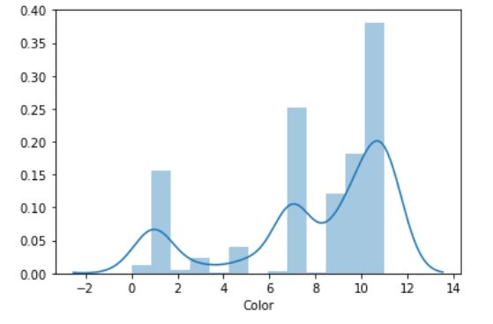
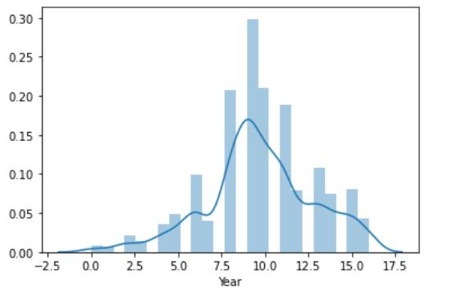
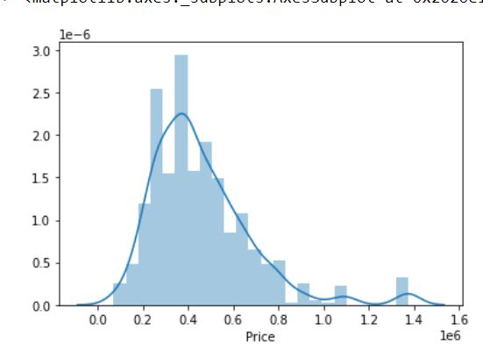
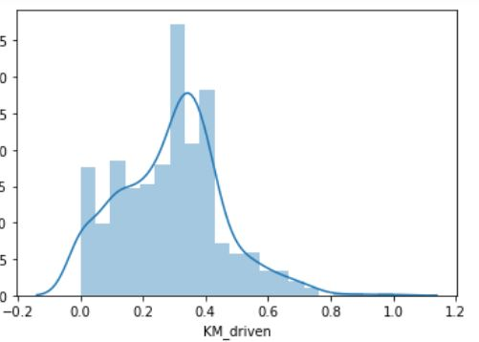
Data Understanding
The distribution of the Price is positively skewed and normal distribution.
The distribution of the Year is slightly symmetrical skewed.
the distribution of the Color is highly positively skewed.
The distribution of the KM_driven is slightly negatively skewed.
Density Plot

Slide 5
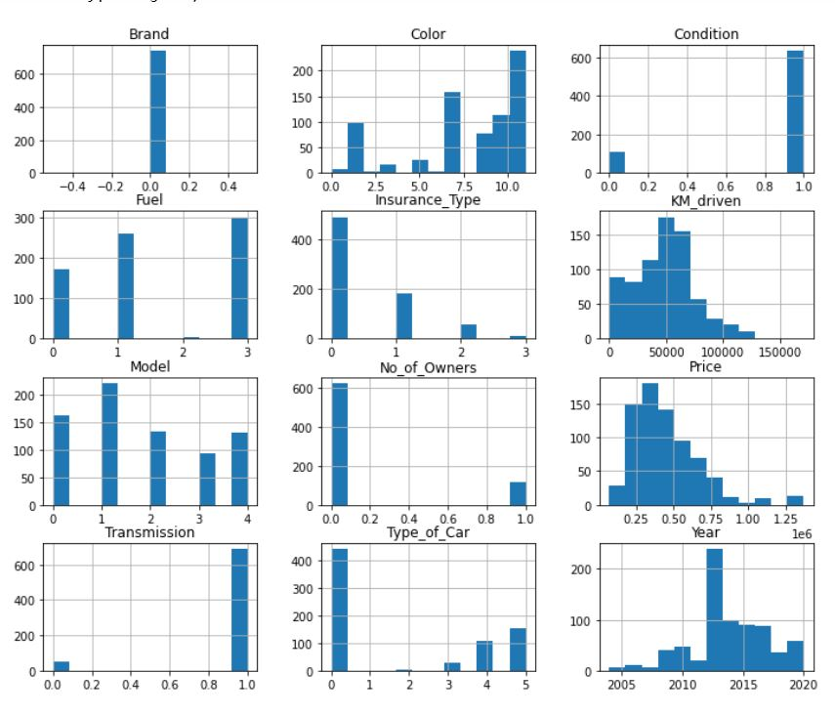
Histogram
There are more no of model only one model Maruti Suzuki car.
There are many type of color of car of Maruti Suzuki.
There are two type of condition new and used car.
There are 4 to 5 model of Marutu Suzuki car.
We observe that is price is between then 120000 to 150000.
There are only two type of owners ,first and second .

Slide 6
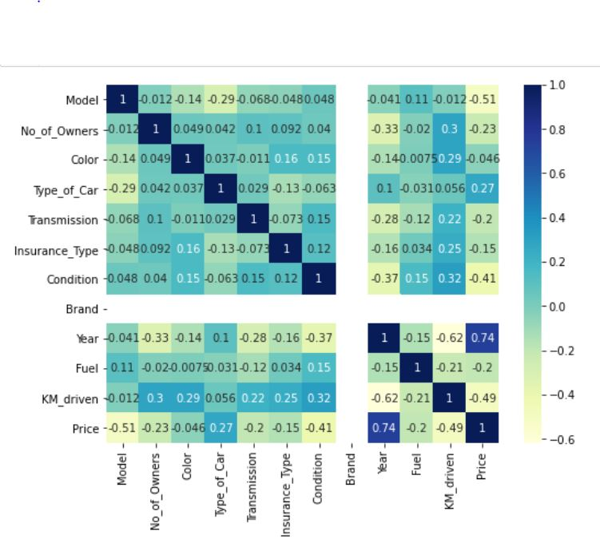
Heat map
There are Interpret Heatmap
all the feature are correlation
Show between each other
There are many feature are
slightly and highly correlation.
There are brand Column are
White line because there are
only use one brand of Maruti
Suzuki.

Slide 7
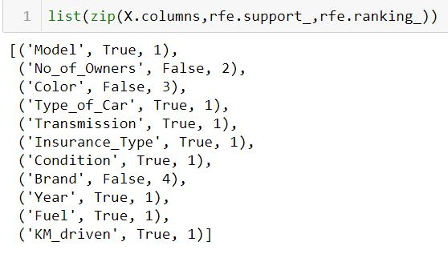
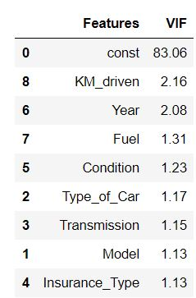
Recursive feature elimination(REF)
Recursive feature elimination with built-in cross-validated selection of the best number of features
There are only using 10-12 features using REF.
Also based on VIF value of feature.

Slide 8
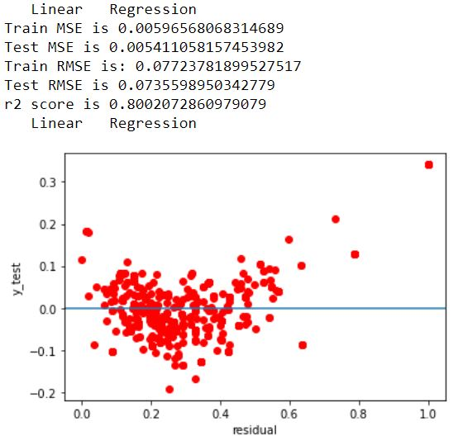
Linear Regression
When used all the features which are encoded to fit the model and the R-squared value is 80.02%.
There are show residual plot its show are random
point.
There are show Train RMSE ,Train MSE, and also show for test .
As the difference between training and testing MSE and RMSE is less the model is not having overfitting

Slide 9
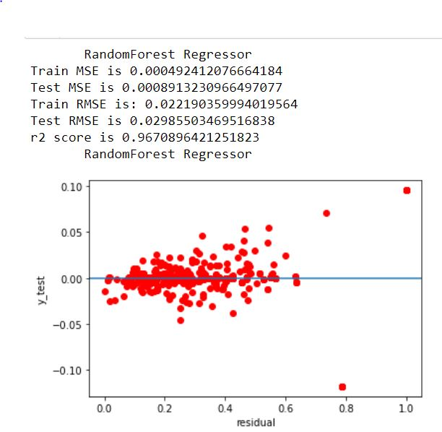
RandomForest Regressor
When used all the features which are encoded to fit the model and the R-squared value96.70%.
There are show residual plot its show are random point.
There are show Train RMSE ,Train MSE, and also show for test .
As the difference between training and testing MSE and RMSE is less the model is not having overfitting

Slide 10
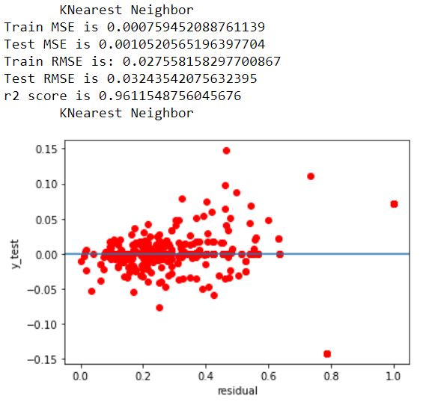
KNearest Neighbor
When used all the features which are encoded to fit the model and the R-squared value is 96.11%.
There are show residual plot its show are random point.
There are show Train RMSE ,Train MSE, and also show for test .
As the difference between training and testing MSE and RMSE is less the model is not having overfitting

Slide 11
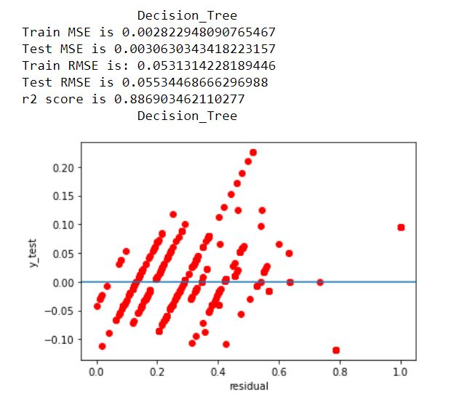
Decision Tree
When used all the features which are encoded to fit the model and the R-squared value is 88.69%.
There are show residual plot its show are random
point.
There are show Train RMSE ,Train MSE, and also show for test .
As the difference between training and testing MSE and RMSE is less the model is not having overfitting

Slide 12
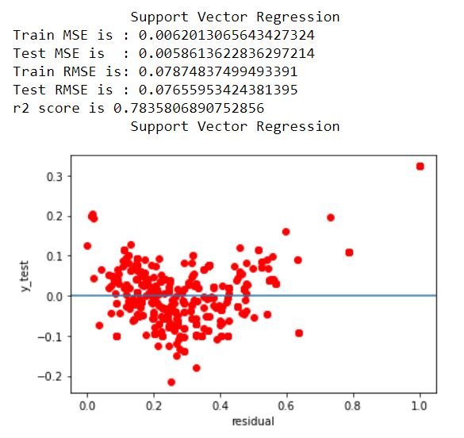
Support Vector Regression
When used all the features which are encoded to fit the model and the R-squared value is 78.38%.
There are show residual plot its show are random
point.
There are show Train RMSE ,Train MSE, and also show for test .

Slide 13
Model Conclusion
We've tried to play with as much stuff and could with this dataset in order to understand the very basic topics about
data interpretation ,selection and data visualization
feature selection and labeling
RandomForest_Regressor,KNeighborsRegressor,GradientBoostingRegressor giving Best R2 of the Regression .

Slide 14
Thank you

